Slide 1



Apps mòbils amb
Introducció a

Slide 2
Índex
Control de versions, que aporta?
Per què git?
Arquitectura
Primers passos

Slide 3
Control de versions, que aporta?

Slide 4


Control de versions, que aporta?
Còpia de seguretat
Treball en equip
Notes:
Backup and Restore. Files are saved as they are edited, and you can jump to any moment in time. Need that file as it was on Feb 23, 2007? No problem.
Synchronization. Lets people share files and stay up-to-date with the latest version.
Short-term undo. Monkeying with a file and messed it up? (That’s just like you, isn’t it?). Throw away your changes and go back to the “last known good” version in the database.
Long-term undo. Sometimes we mess up bad. Suppose you made a change a year ago, and it had a bug. Jump back to the old version, and see what change was made that day.
Track Changes. As files are updated, you can leave messages explaining why the change happened (stored in the VCS, not the file). This makes it easy to see how a file is evolving over time, and why.
Track Ownership. A VCS tags every change with the name of the person who made it. Helpful for blamestorming giving credit.
Sandboxing, or insurance against yourself. Making a big change? You can make temporary changes in an isolated area, test and work out the kinks before “checking in” your changes.
Branching and merging. A larger sandbox. You can branch a copy of your code into a separate area and modify it in isolation (tracking changes separately). Later, you canmerge your work back into the common area.

Slide 5





Control de versions, que aporta?
Còpia de seguretat
Treball en equip
Desfer (curt/llarg termini)
Control de Canvis
Autoria
Assegurança personal
Branques
Notes:
Backup and Restore. Files are saved as they are edited, and you can jump to any moment in time. Need that file as it was on Feb 23, 2007? No problem.
Synchronization. Lets people share files and stay up-to-date with the latest version.
Short-term undo. Monkeying with a file and messed it up? (That’s just like you, isn’t it?). Throw away your changes and go back to the “last known good” version in the database.
Long-term undo. Sometimes we mess up bad. Suppose you made a change a year ago, and it had a bug. Jump back to the old version, and see what change was made that day.
Track Changes. As files are updated, you can leave messages explaining why the change happened (stored in the VCS, not the file). This makes it easy to see how a file is evolving over time, and why.
Track Ownership. A VCS tags every change with the name of the person who made it. Helpful for blamestorming giving credit.
Sandboxing, or insurance against yourself. Making a big change? You can make temporary changes in an isolated area, test and work out the kinks before “checking in” your changes.
Branching and merging. A larger sandbox. You can branch a copy of your code into a separate area and modify it in isolation (tracking changes separately). Later, you canmerge your work back into the common area.

Slide 6
Per què git?

Slide 7
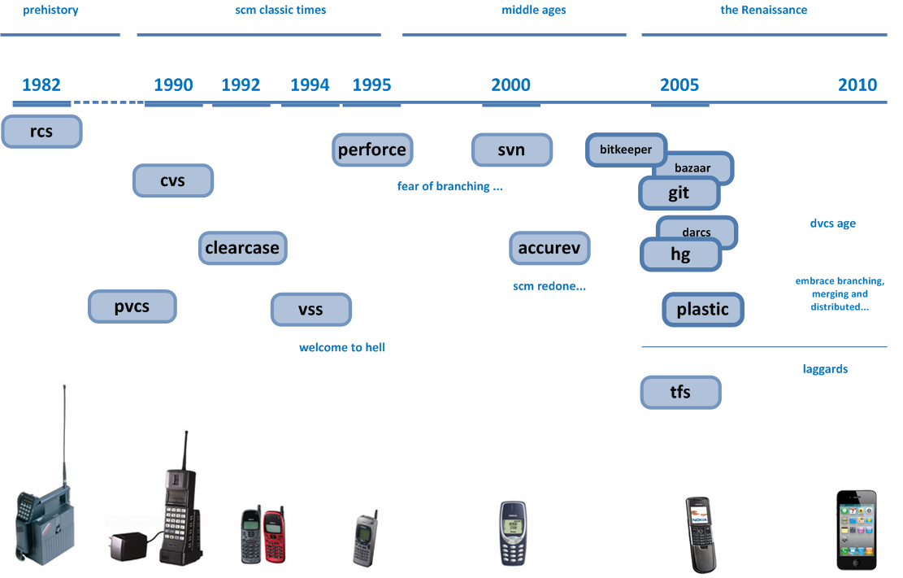
Per què git?

Slide 8
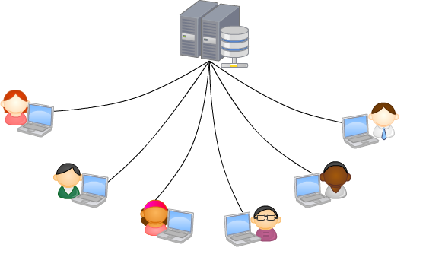
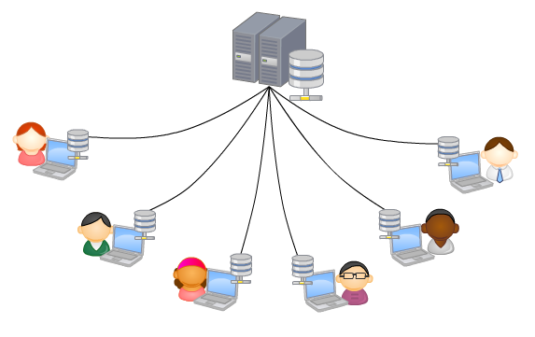
Per què git?
Distribuït
Treballar sense connexió
Moltes copies independents

Slide 9
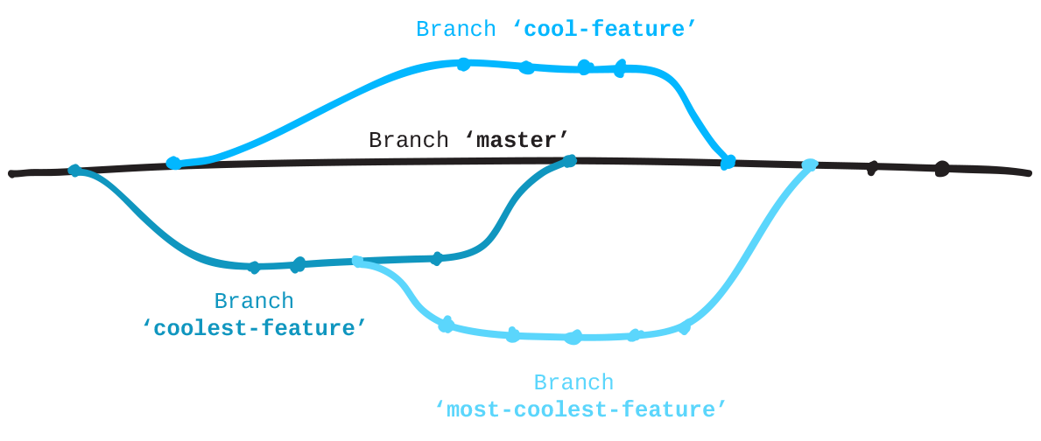
Per què git?
Branques aïllades

Slide 10
Per què git?
Fàcil afegir - molt difícil esborrar/perdre
Workflow lliure
Control absolut del commit
Gran comunitat darrera de git

Slide 11
Arquitectura

Slide 12
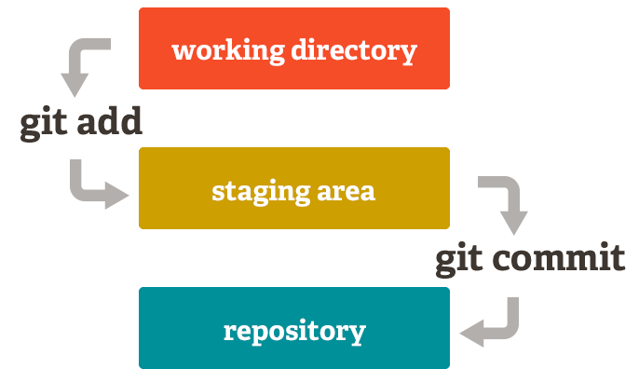

Arquitectura
.gitignore

Slide 13
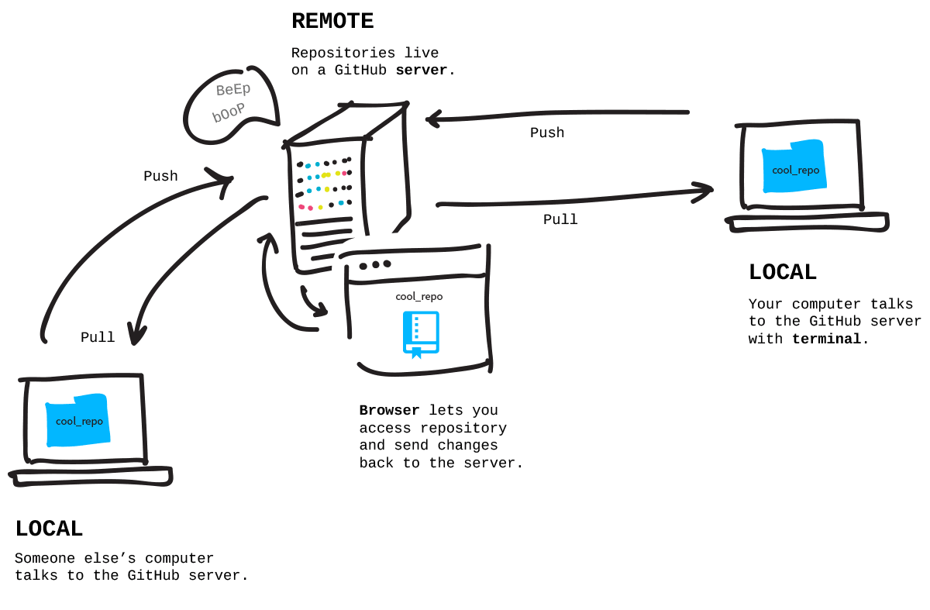
Arquitectura

Slide 14
Primers passos

Slide 15
Primers passos
$ cd path/al/nou/repo
$ git init
$ git remote add origin https://…
→ Es crea el directori /.git/
→ S’afegeix el servidor al projecte amb el nom origin

Slide 16
Primers passos
$ cd path/
$ git clone https://...
→ Es crea una copia local al directori

Slide 17
Primers passos
$ git add .
$ git status
$ git commit -m "Primer commit"
→ S’afegeixen tots els fitxers a la llista per afegir al commit
→ Mostra l’estat dels canvis
→ Es crea el commit amb els canvis

Slide 18
Primers passos
$ git push origin master
$ git pull origin master
→ S’envien els canvis al remote “origin”
→ Es recuperen els canvis d’”origin”

Slide 19
Q&A
Notes:
Presentación de Gavi!

Slide 20
Font imatges
https://duzun.me/tips/git
https://git-scm.com/about/staging-area
http://jlord.us/git-it/challenges/branches_arent_just_for_birds.html
http://codicesoftware.blogspot.com/2010/11/version-control-timeline.html
https://pixabay.com
https://www.iconfinder.com/

